Slide 1


Scoping
Data and AI
Projects
Defining the Scope of Data and AI Initiatives
SQL Sat MN 2025

Slide 2

Defining the Scope of Data and AI Initiatives
The session goes beyond theoretical principles, offering actionable insights and practical tools tailored for real-world application. Learn how to use a scoping framework for success in Data and AI initiatives. Participants will gain the skills to craft precise problem statements, define measurable deliverable goals, and establish actionable scopes that drive projects forward. Through interactive discussions and case studies, attendees will explore strategies to navigate complexities, mitigate risks, and ensure alignment with organizational priorities. Whether tackling customer retention challenges or optimizing operational workflows, this presentation equips participants to transform abstract concepts into tangible results. This includes identifying constraints, and creating an execution plan, with milestones, resources, deadlines and communication plans. Join Ross McNeely as he presents scoping best practices for Data and AI project refined from over 80+ engagements. Effective project scoping and planning is essential for ensuring success.

Slide 3

Presenter: Ross McNeely
Practice Manager, Data & Analytics
Solution Architecture | Trace3
Client Solutions
Team Engineers
Growth
80+
41
13%
www.linkedin.com/in/rossmcneely
https://rossmcneely.com/
Notes:
Why is this important for scope?

Slide 4

Agenda for Scoping Data and AI Projects
Understanding project objectives and business goals
Identifying data sources and assessing data quality
Defining Data & AI capabilities technology requirements
Aligning teams and stakeholders for collaboration
Establishing timelines and success metrics
Notes:
Key areas to focus on when scoping data and AI projects. We start by clarifying goals, then assess data readiness, define AI tools needed, ensure team alignment, and finally set clear timelines and metrics for measuring success.

Slide 5

Understanding project objectives
&
business goals
Metrics
Notes:
Why is this important for scope?

Slide 6
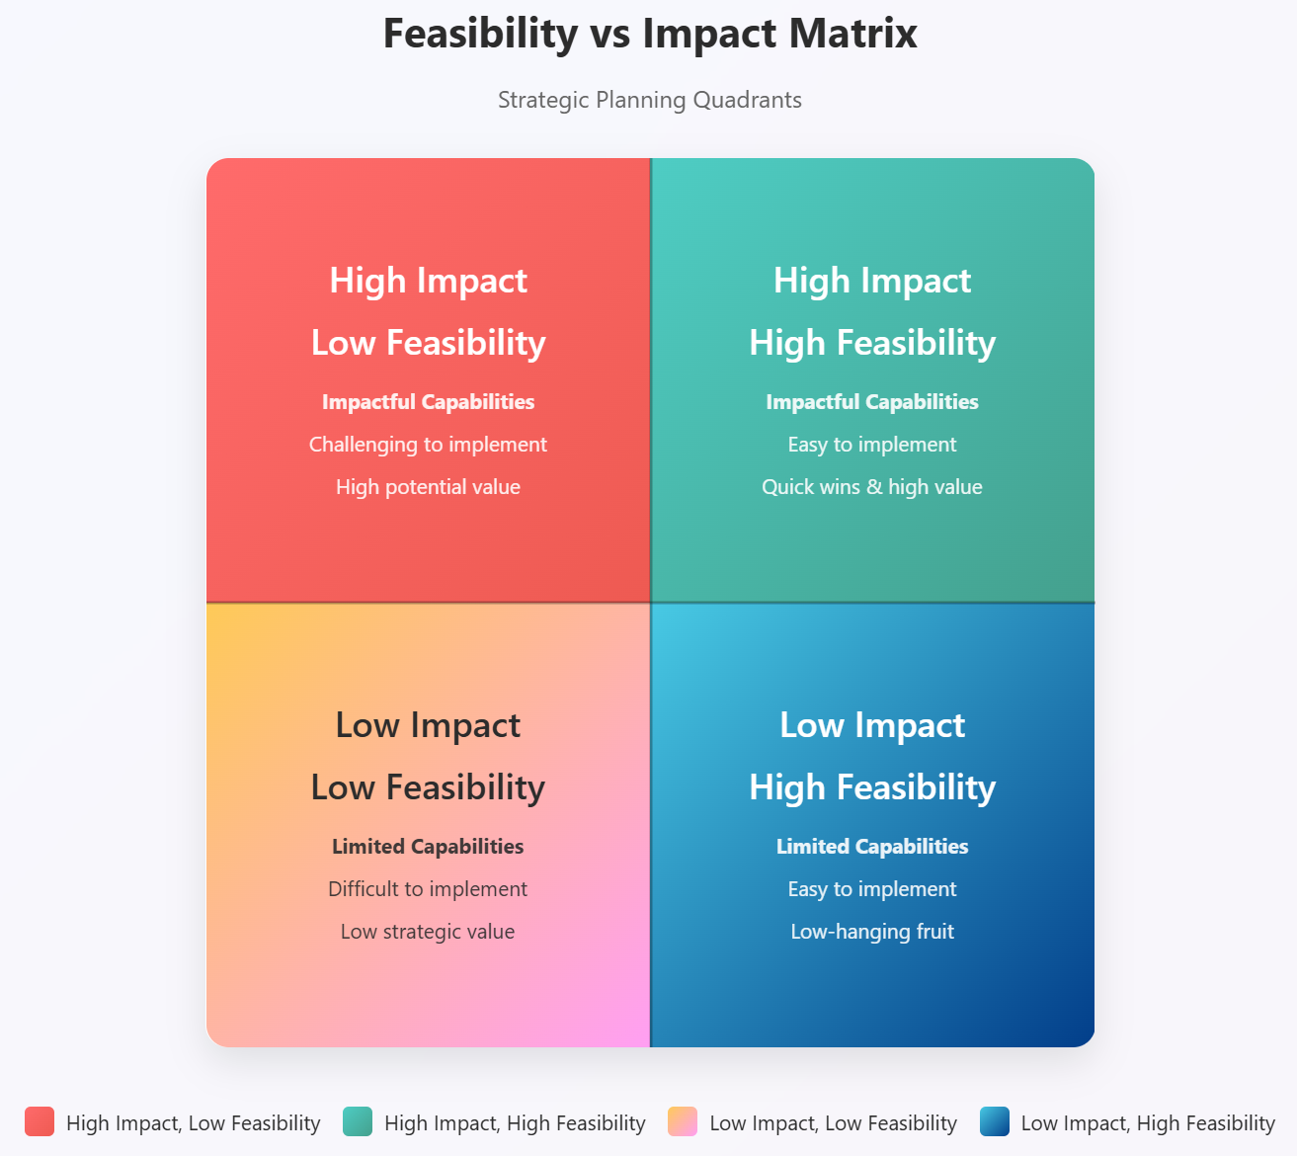

Understanding project objectives
&
business goals
Notes:
Why is this important for scope?

Slide 7
Goal
Input
Process
Output
Feedback
Operations
Understanding project objectives & feedback
Notes:
Why is this important for scope?

Slide 8
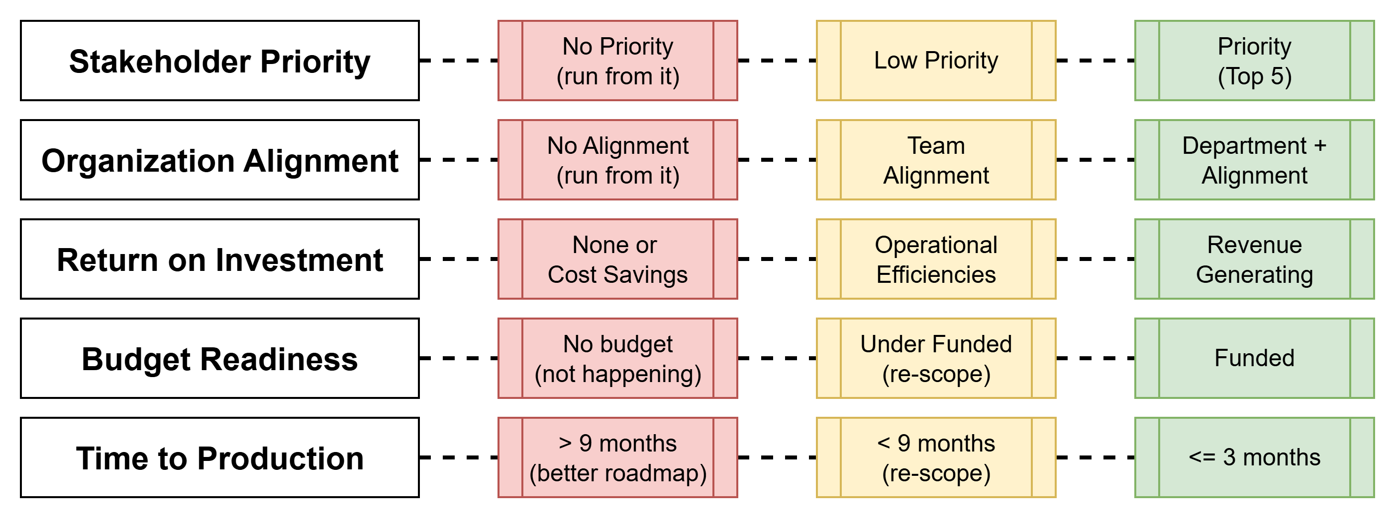
Understanding project objectives & feedback
Notes:
Why is this important for scope?

Slide 9

Identifying data sources and assessing data quality
Notes:
Why is this important for scope?

Slide 10
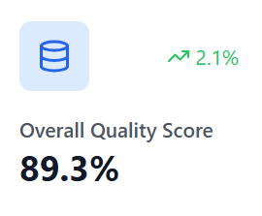
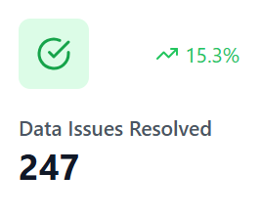
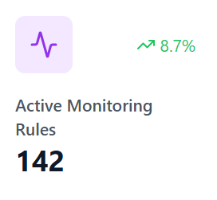
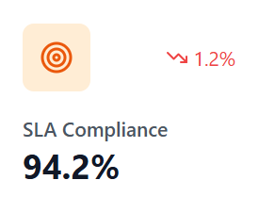
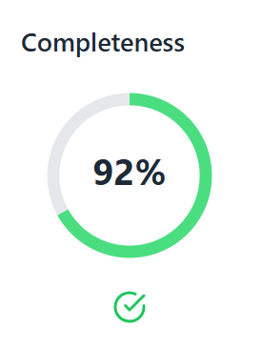
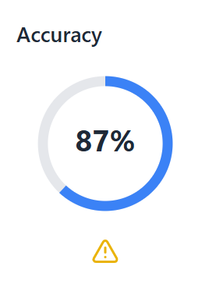
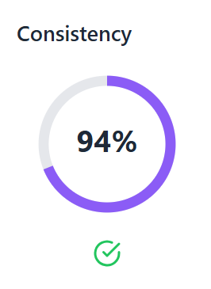
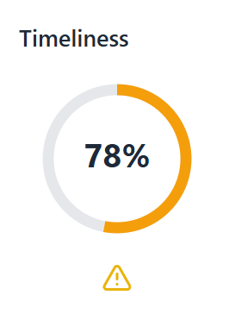
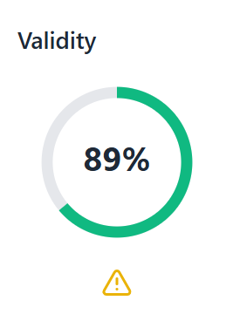
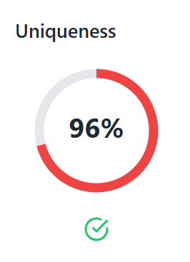
Identifying data sources and assessing data quality
Notes:
Why is this important for scope?

Slide 11
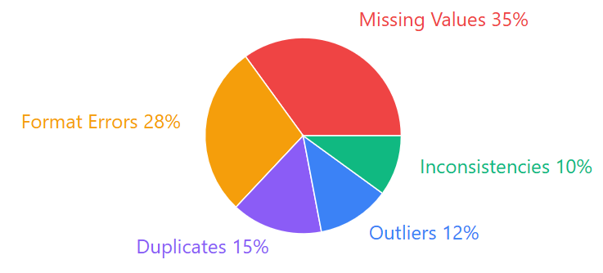
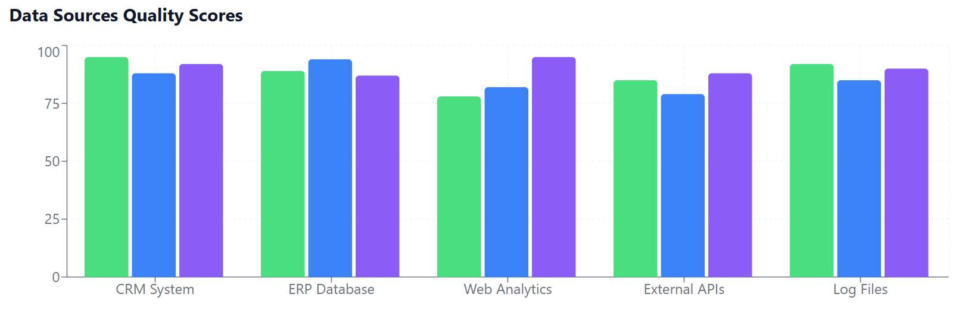
Identifying data sources and assessing data quality

Slide 12
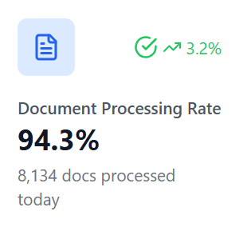
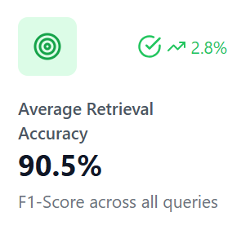
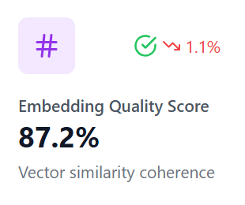
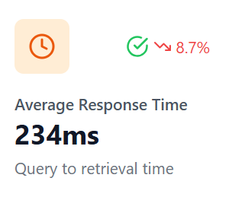
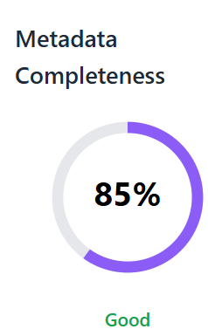
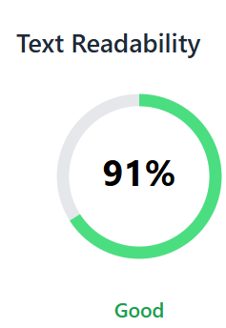
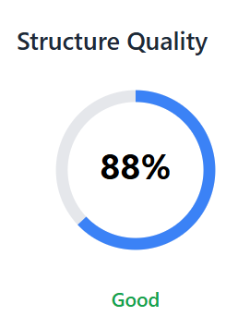
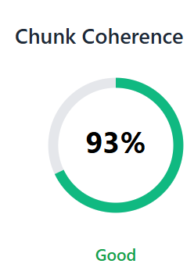
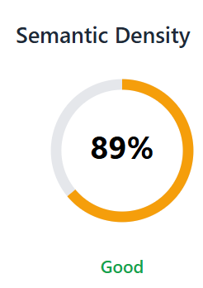
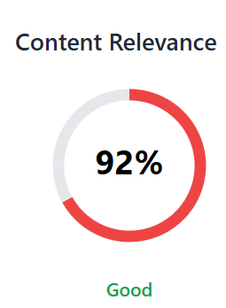
Identifying document sources and assessing document quality
Notes:
Why is this important for scope?

Slide 13

Defining Data & AI capabilities, technology requirements
Notes:
Why is this important for scope?

Slide 14
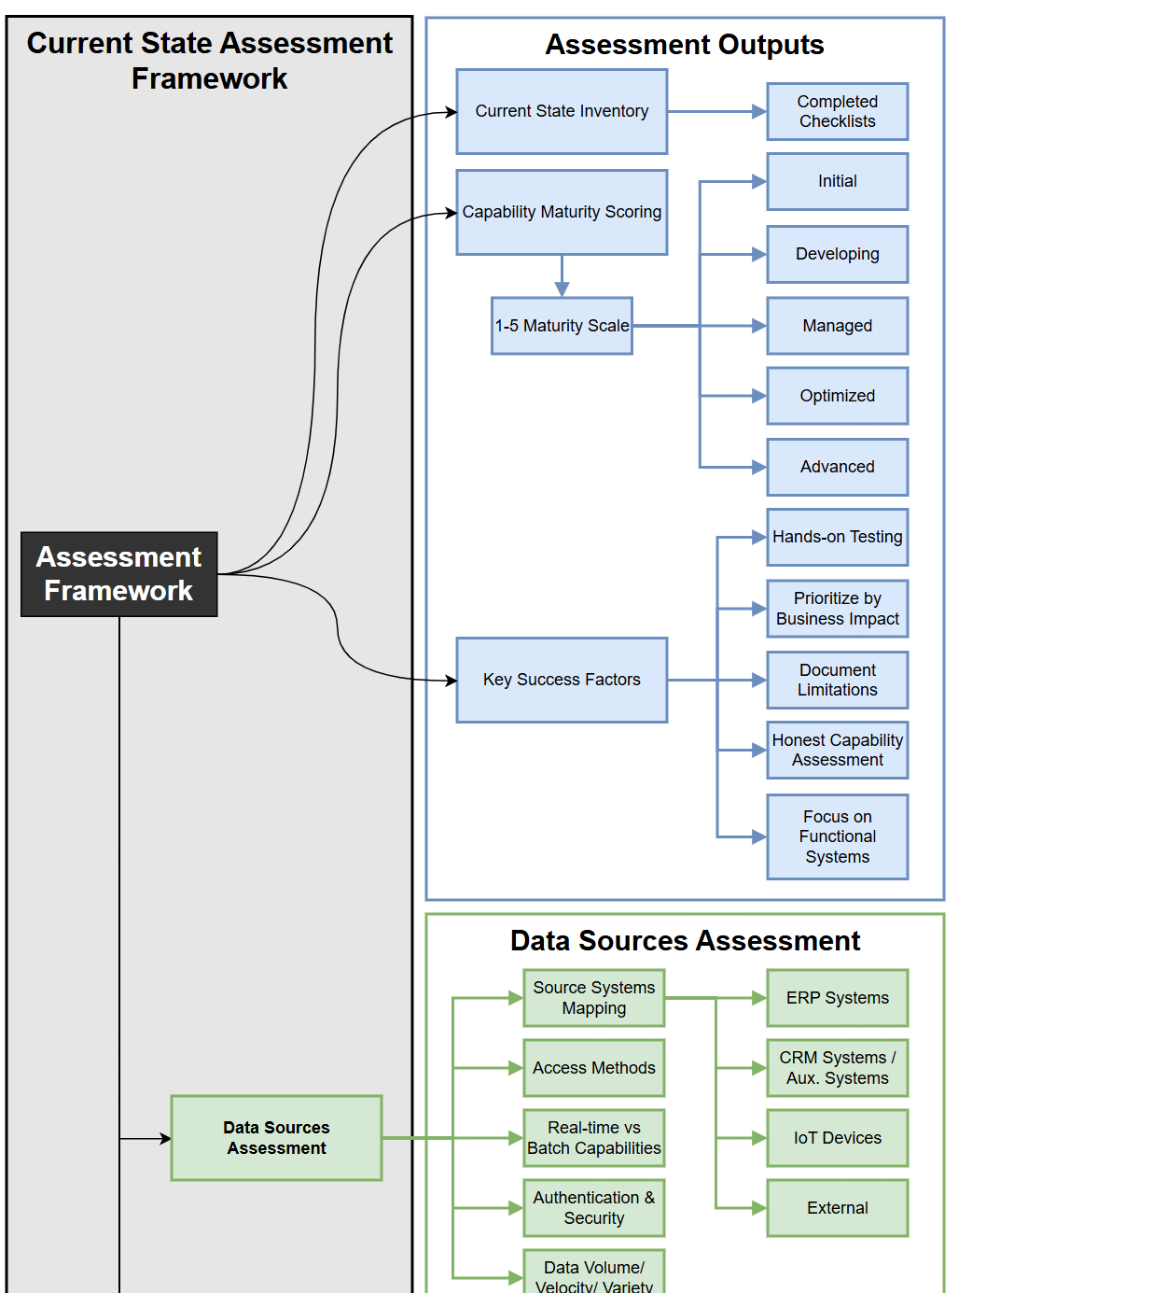
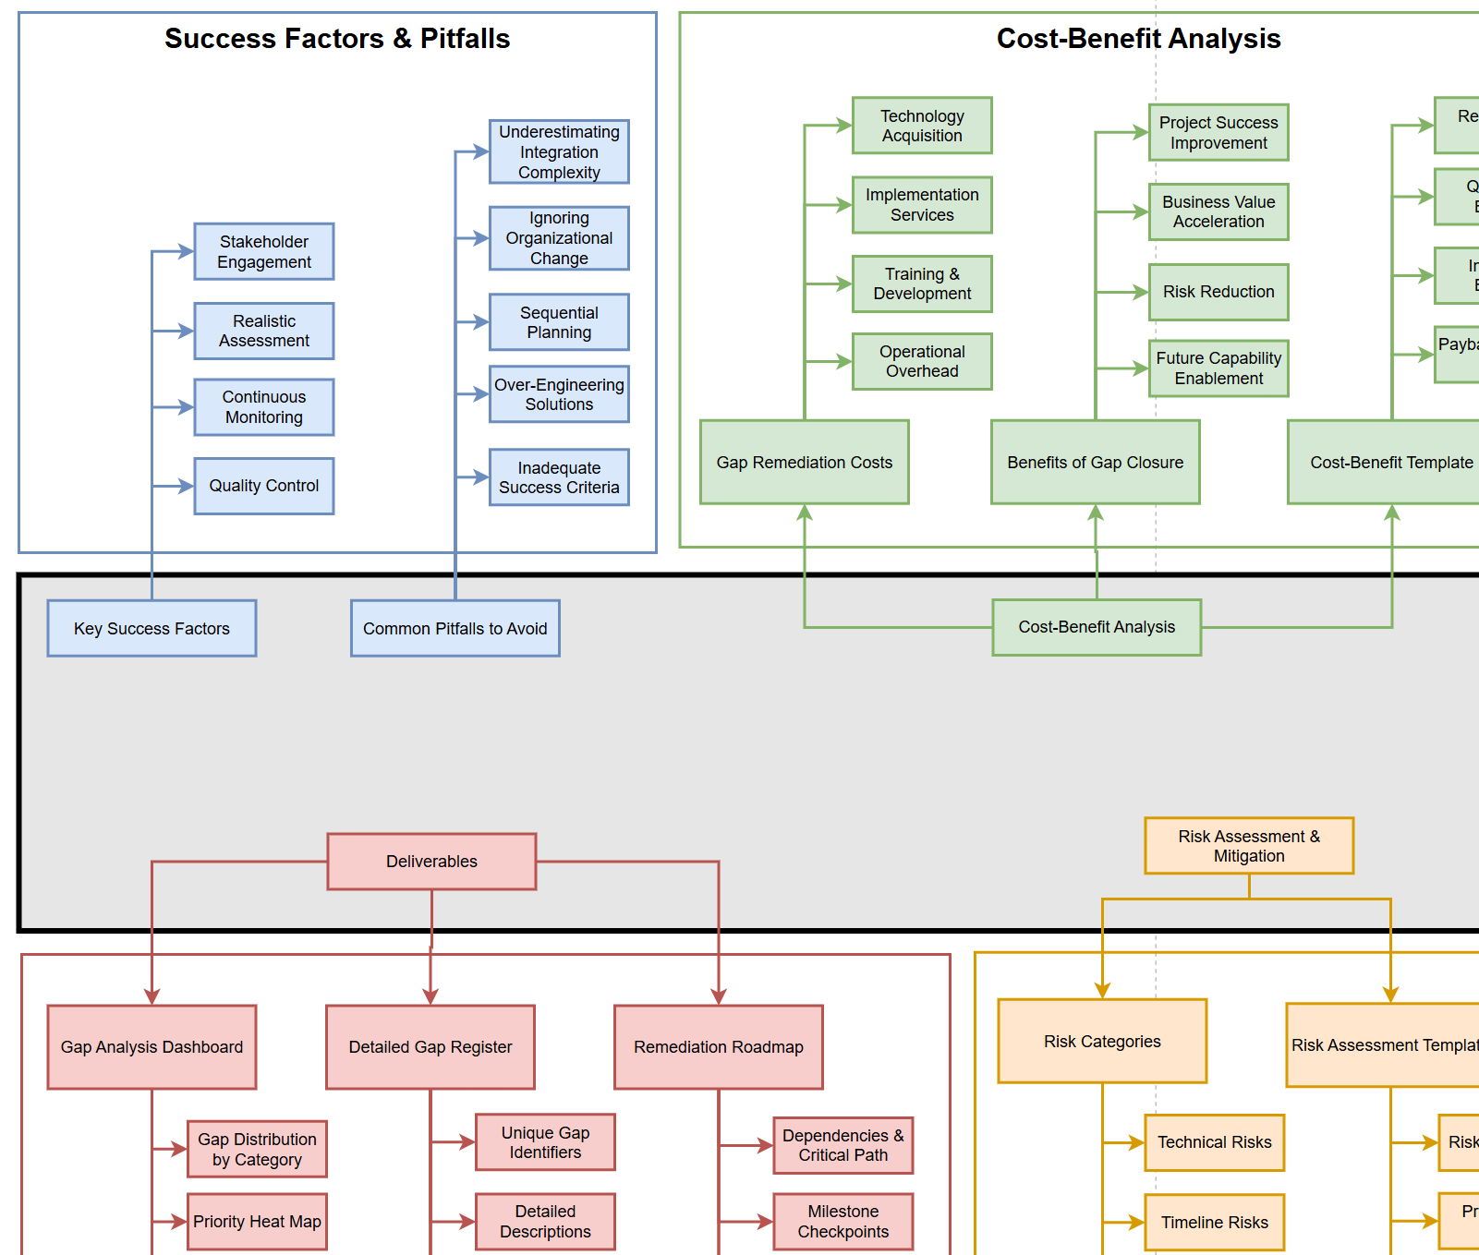
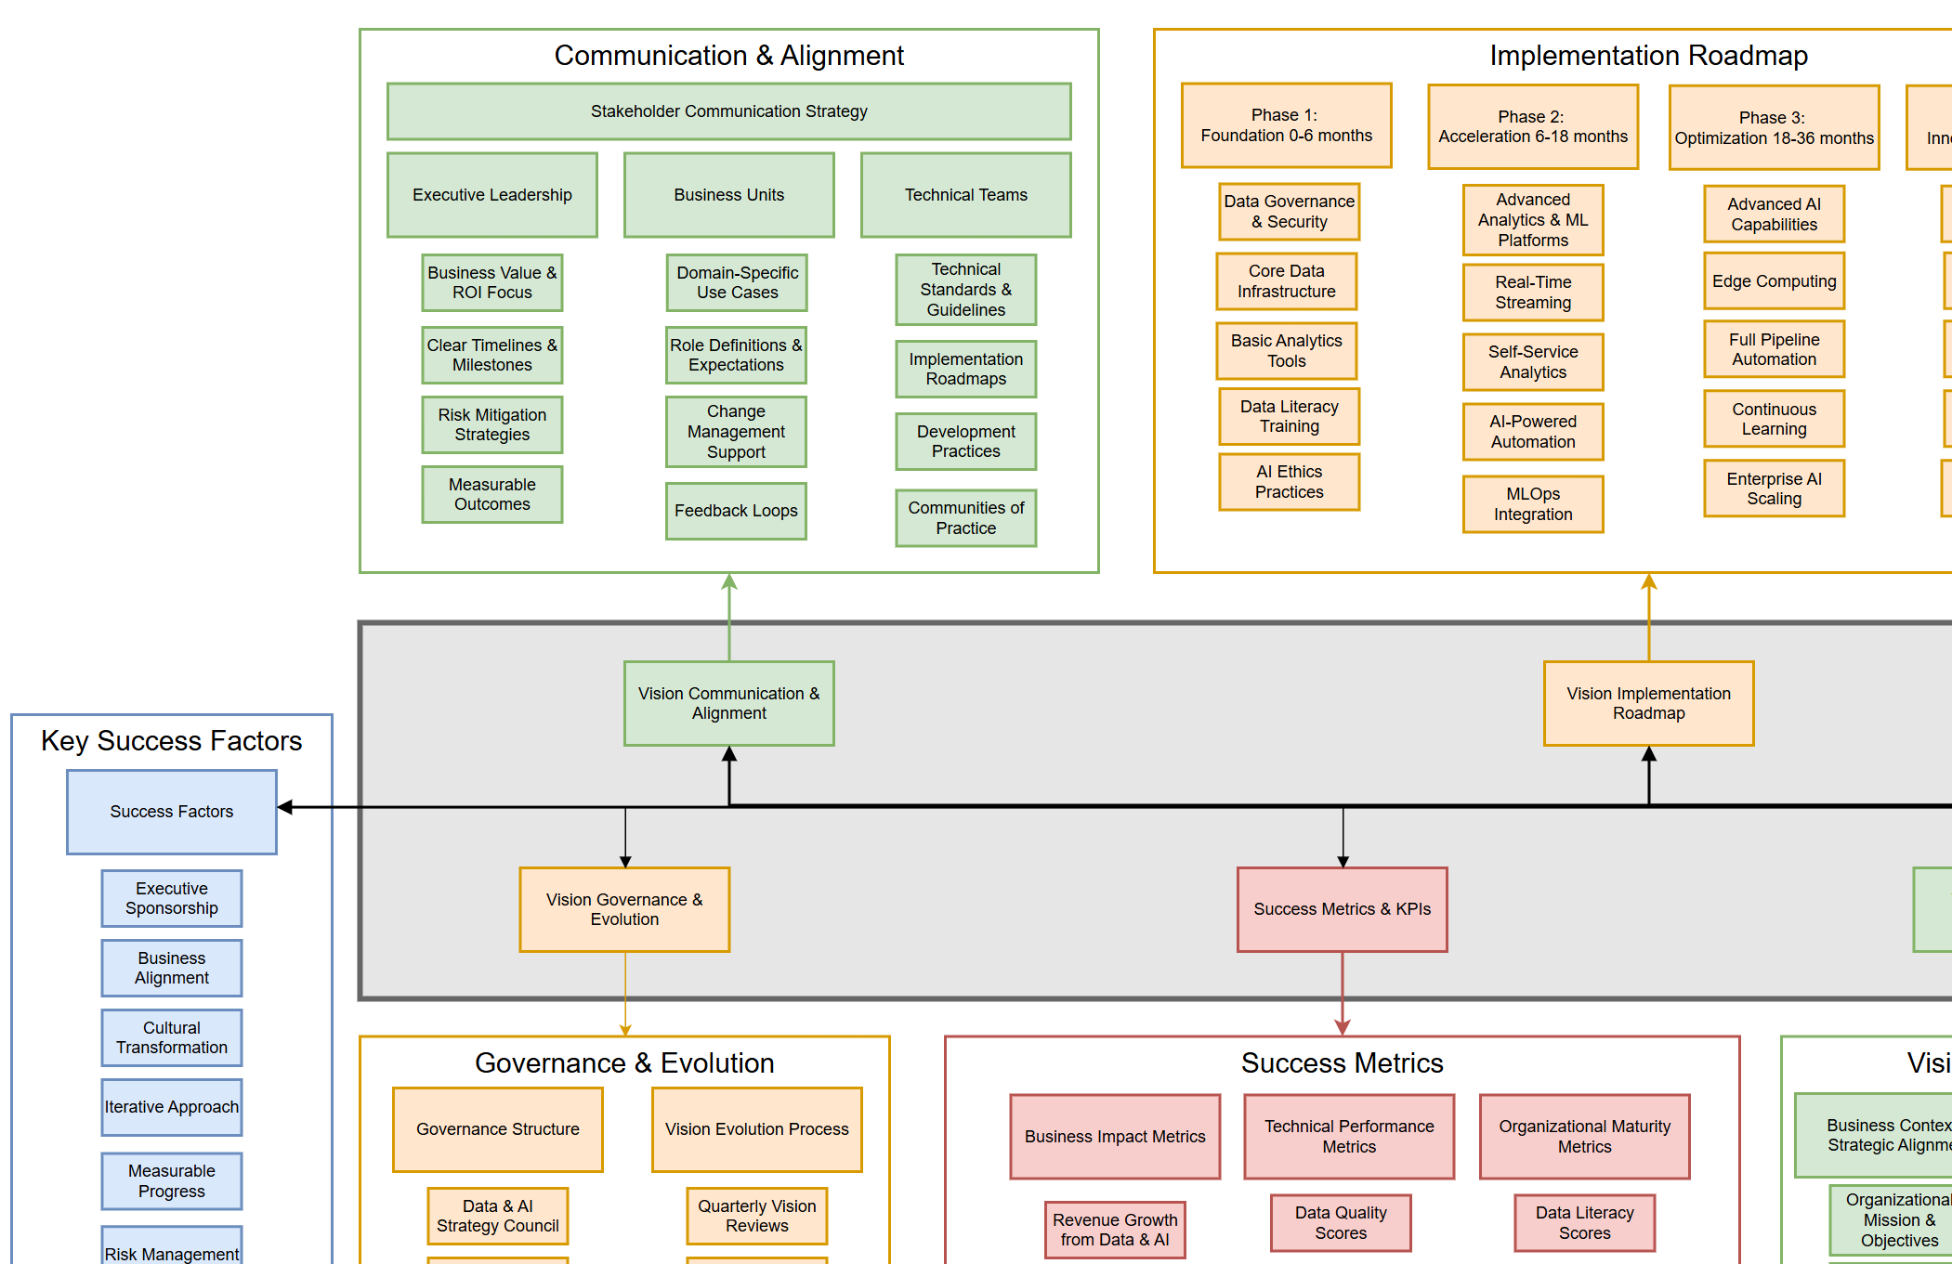
Current State
Data & AI Need
Principles
Architecture
Operations
Requirements
Product
Gap Analysis
Future State
Notes:
Why is this important for scope?

Slide 15
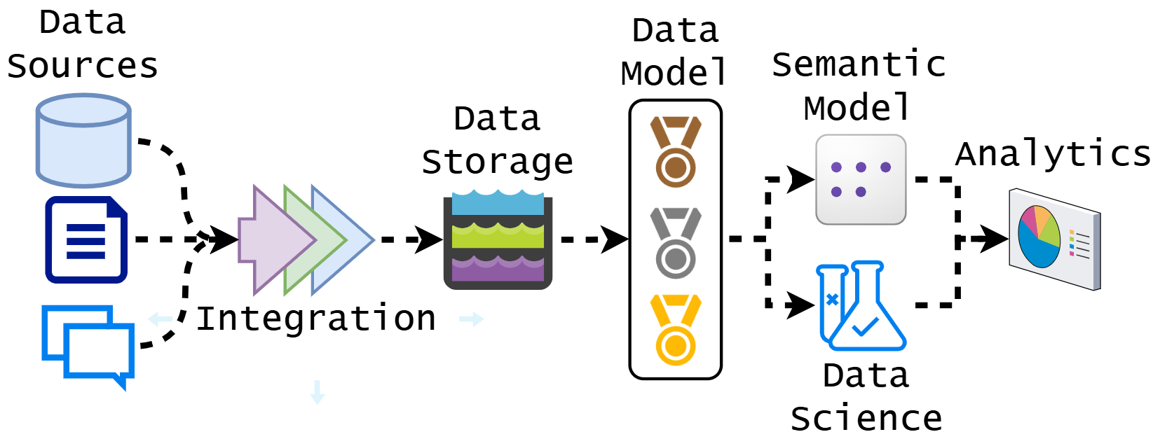
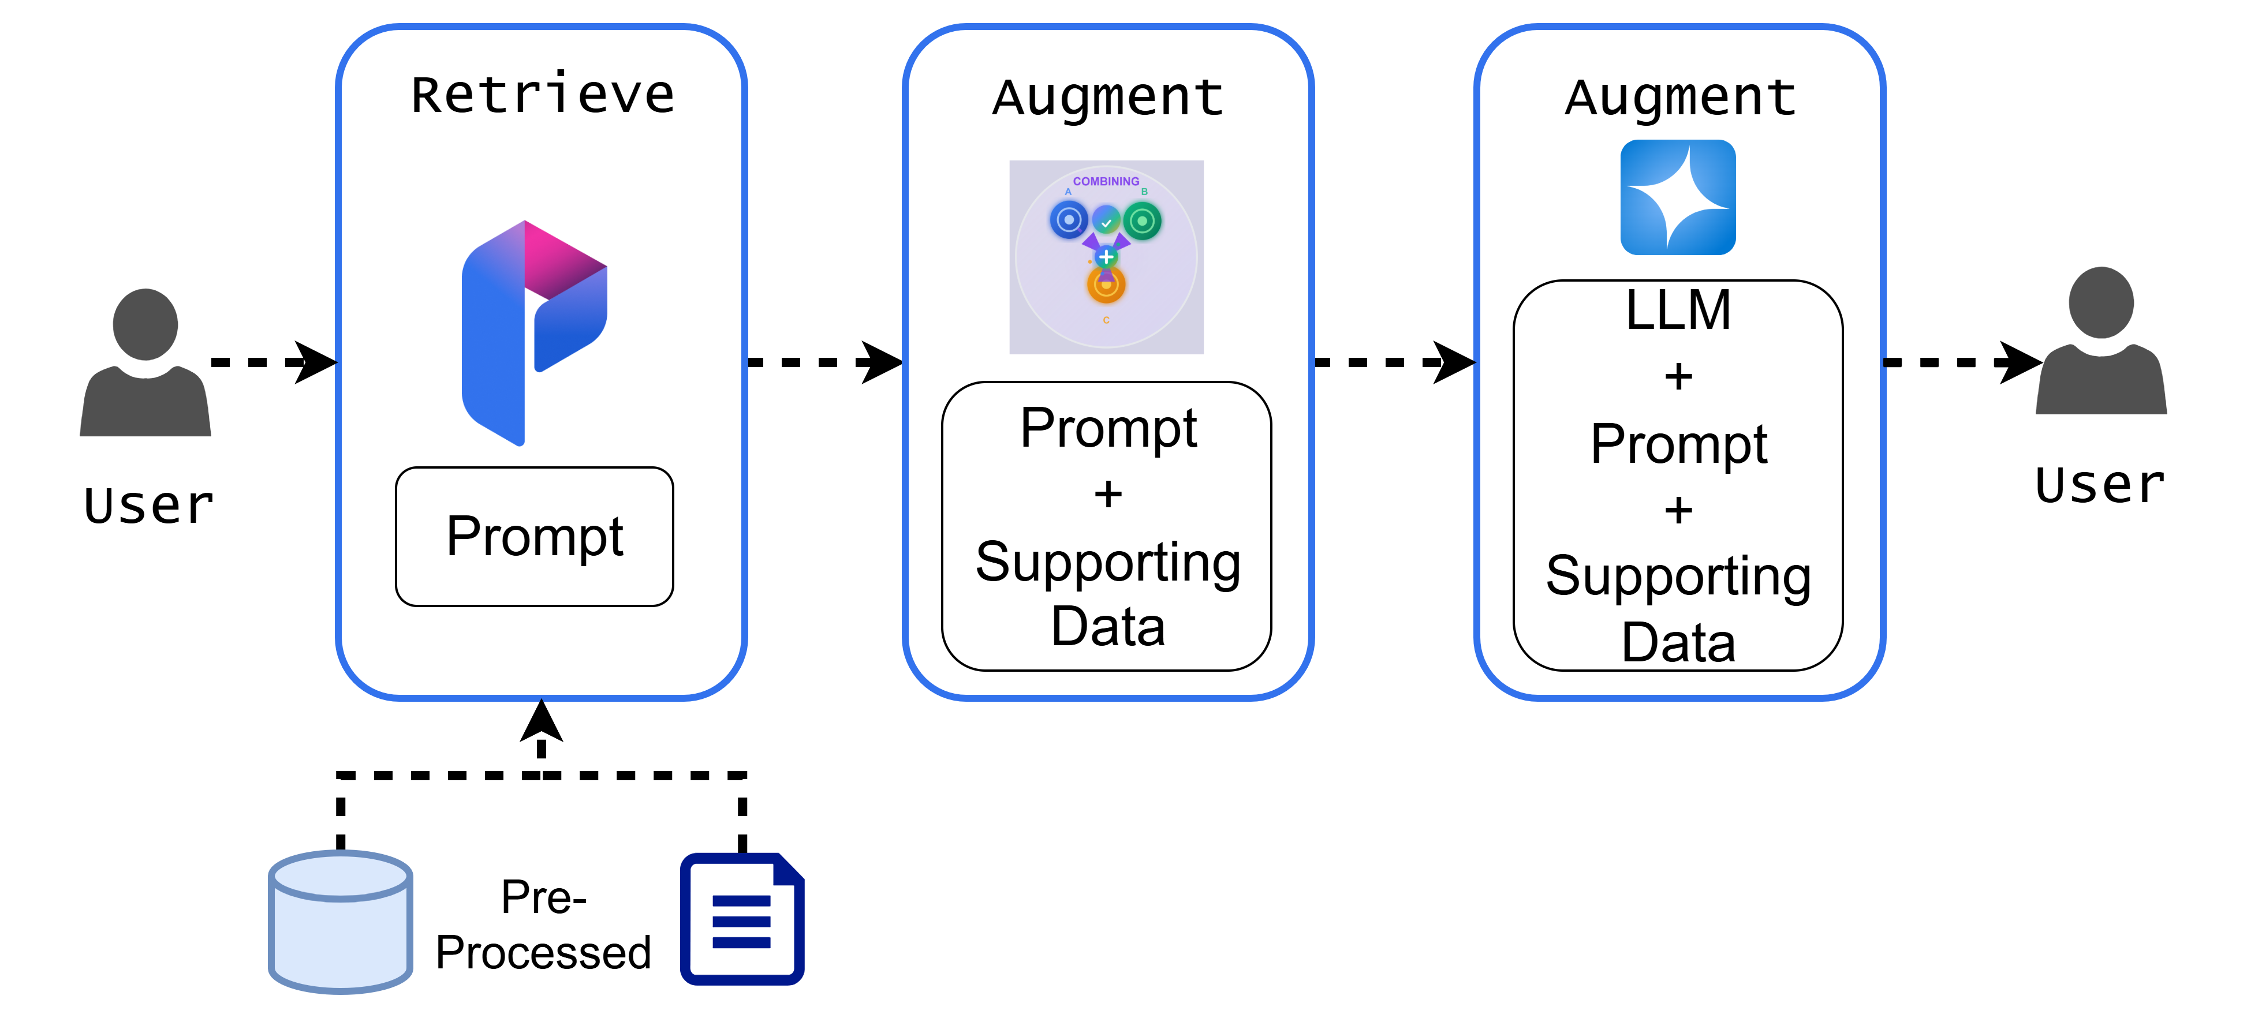
Defining Data & AI capabilities technology requirements

Slide 16
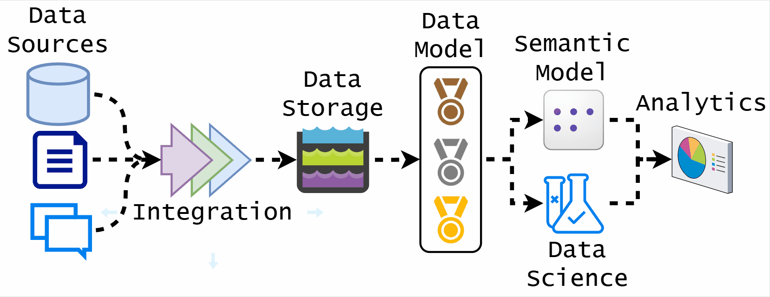
Data Capabilities
Notes:
Why is this important for scope?

Slide 17
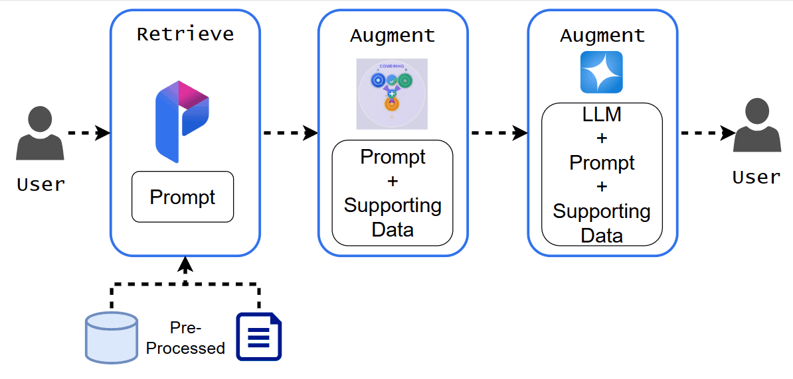
AI Capabilities
Notes:
Why is this important for scope?

Slide 18

Aligning teams
&
stakeholders for collaboration
Notes:
Why is this important for scope?

Slide 19
The Basics
Stakeholder Mapping and Analysis
Establishing Clear Roles and Responsibilities
Communication Framework Development
Aligning teams
&
stakeholders for collaboration
Notes:
Why is this important for scope?

Slide 20
The Labyrinth
Managing Competing Priorities and Expectations
Building Cross-Functional Trust and Buy-in
Governance and Decision-Making Structures
Aligning teams
&
stakeholders for collaboration
Notes:
Why is this important for scope?

Slide 21
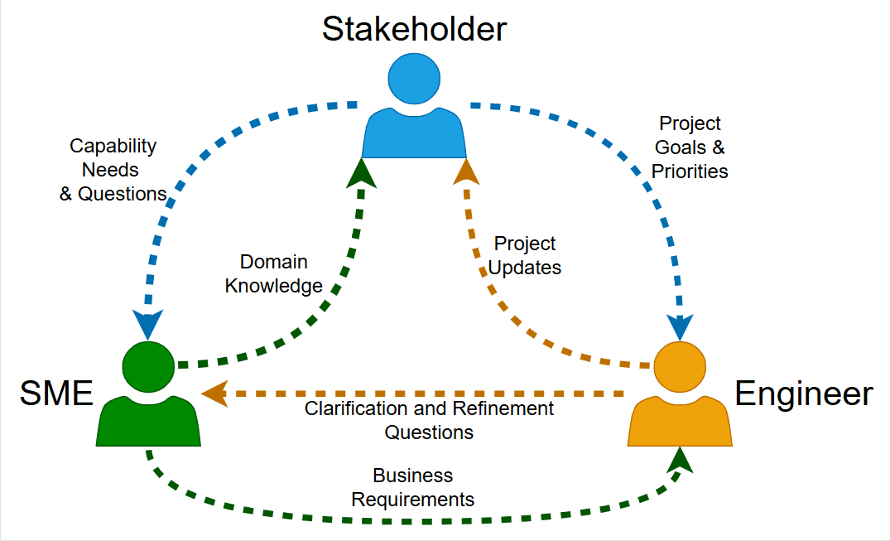
Aligning teams
&
stakeholders for collaboration
Notes:
Why is this important for scope?

Slide 22
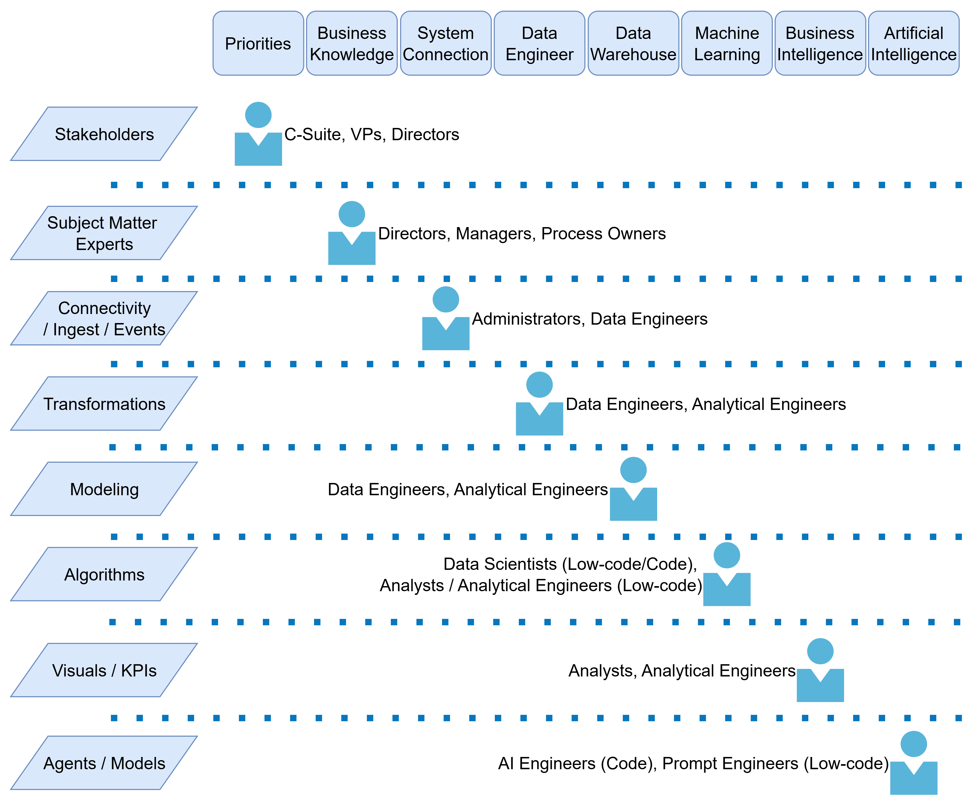
Aligning teams
&
stakeholders for collaboration
Notes:
Why is this important for scope?

Slide 23

Establishing timelines
&
success metrics
Notes:
Why is this important for scope?

Slide 24
Business Need
Ingest
Problem
Establishing timelines
&
success metrics
Vision
Transformation
Data Discovery
Principles
Medallion Architecture
Experiment & Model
Capabilities
Analytics
Enrich & Operationalize
Requirements
Conversational
Analytics
Insights & Monitoring
Notes:
Why is this important for scope?

Slide 25
Timeline Strategies
Phased Delivery Approach
Critical Path Approach
Establishing timelines
&
success metrics
Success Metrics Framework
Investment Metrics
Project Telemetry
Notes:
Why is this important for scope?

Slide 26
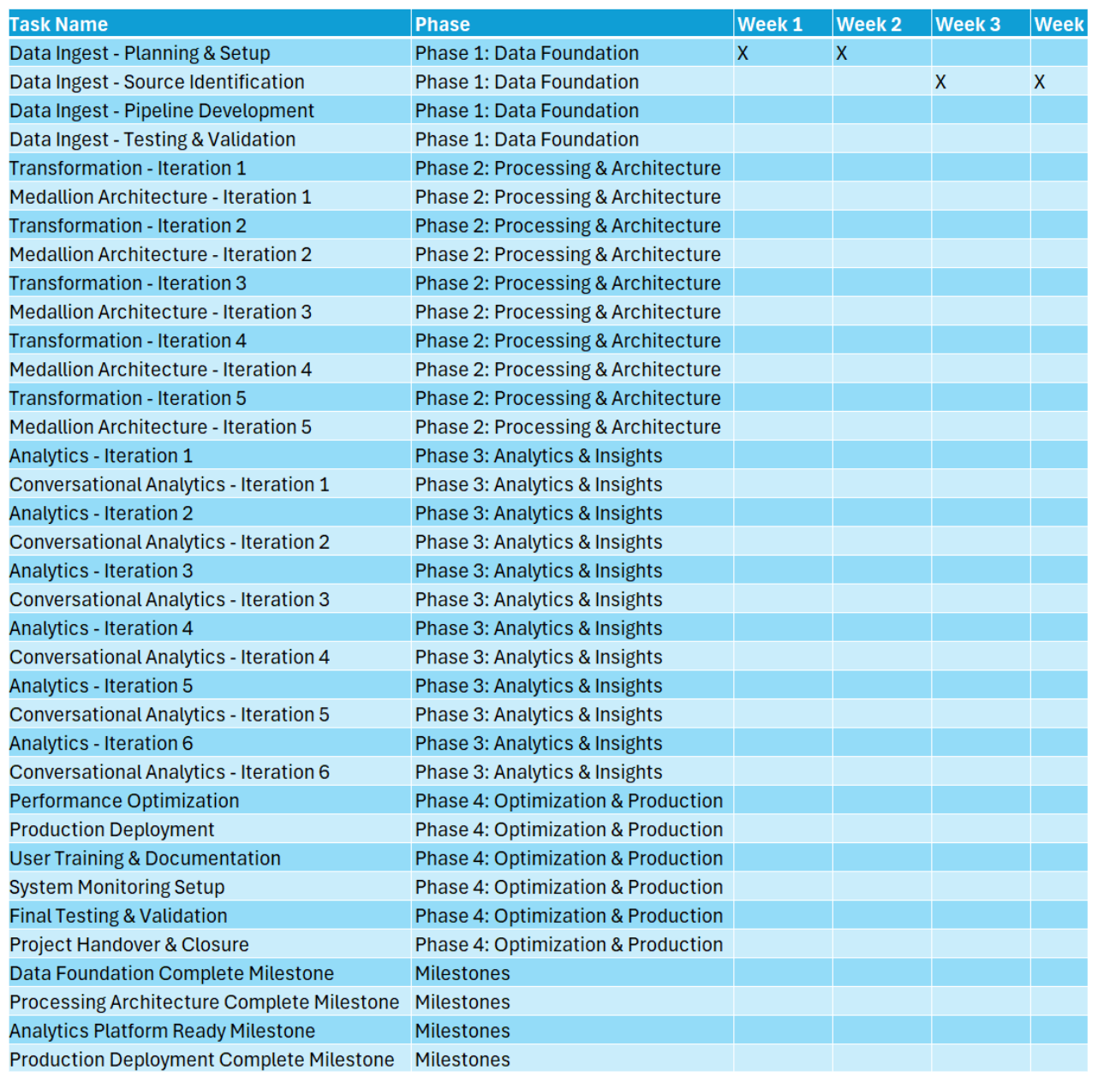
Establishing timelines
&
success metrics
Notes:
Why is this important for scope?

Slide 27
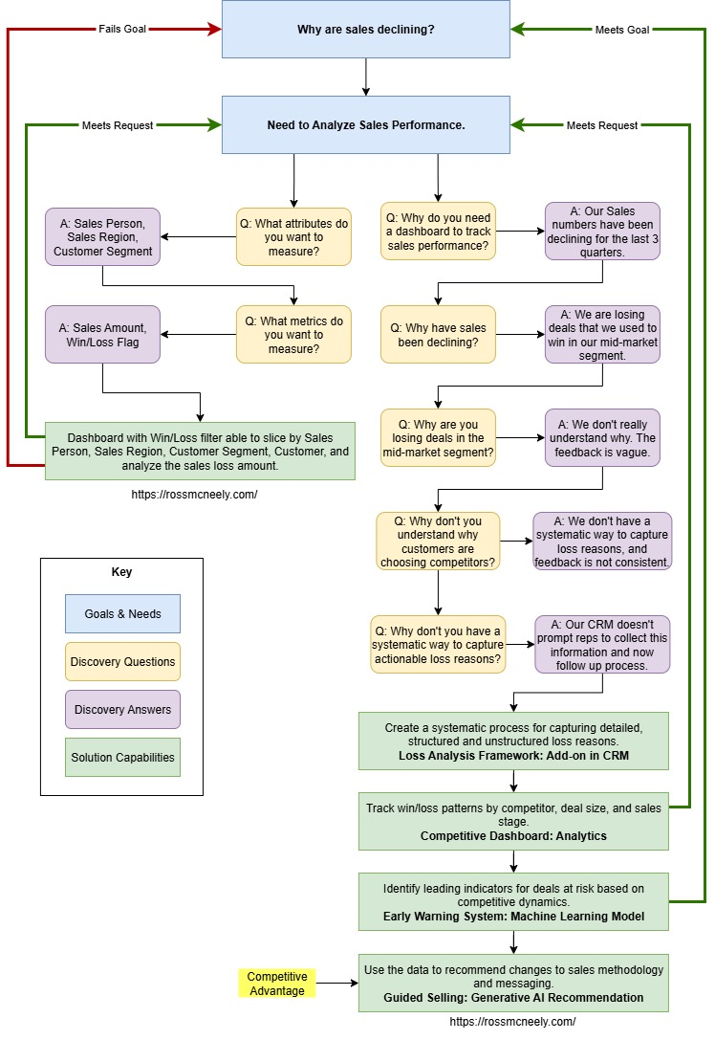
Understanding project objectives & business goals
The Foundation of Data and AI Project Success: Understanding Project Objectives and Business Goals – Ross McNeely
Notes:
Why is this important for scope?

Slide 28
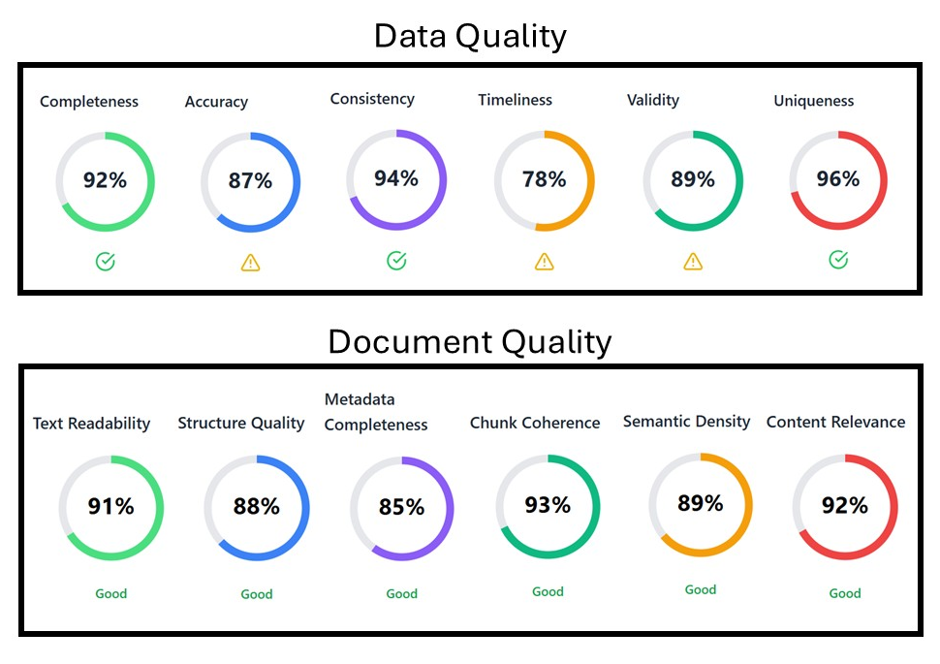
Identifying data & document sources and assessing quality
The Data Detective: How Quality Assessment Shapes Successful Data and AI Project Scoping – Ross McNeely
Notes:
Why is this important for scope?

Slide 29
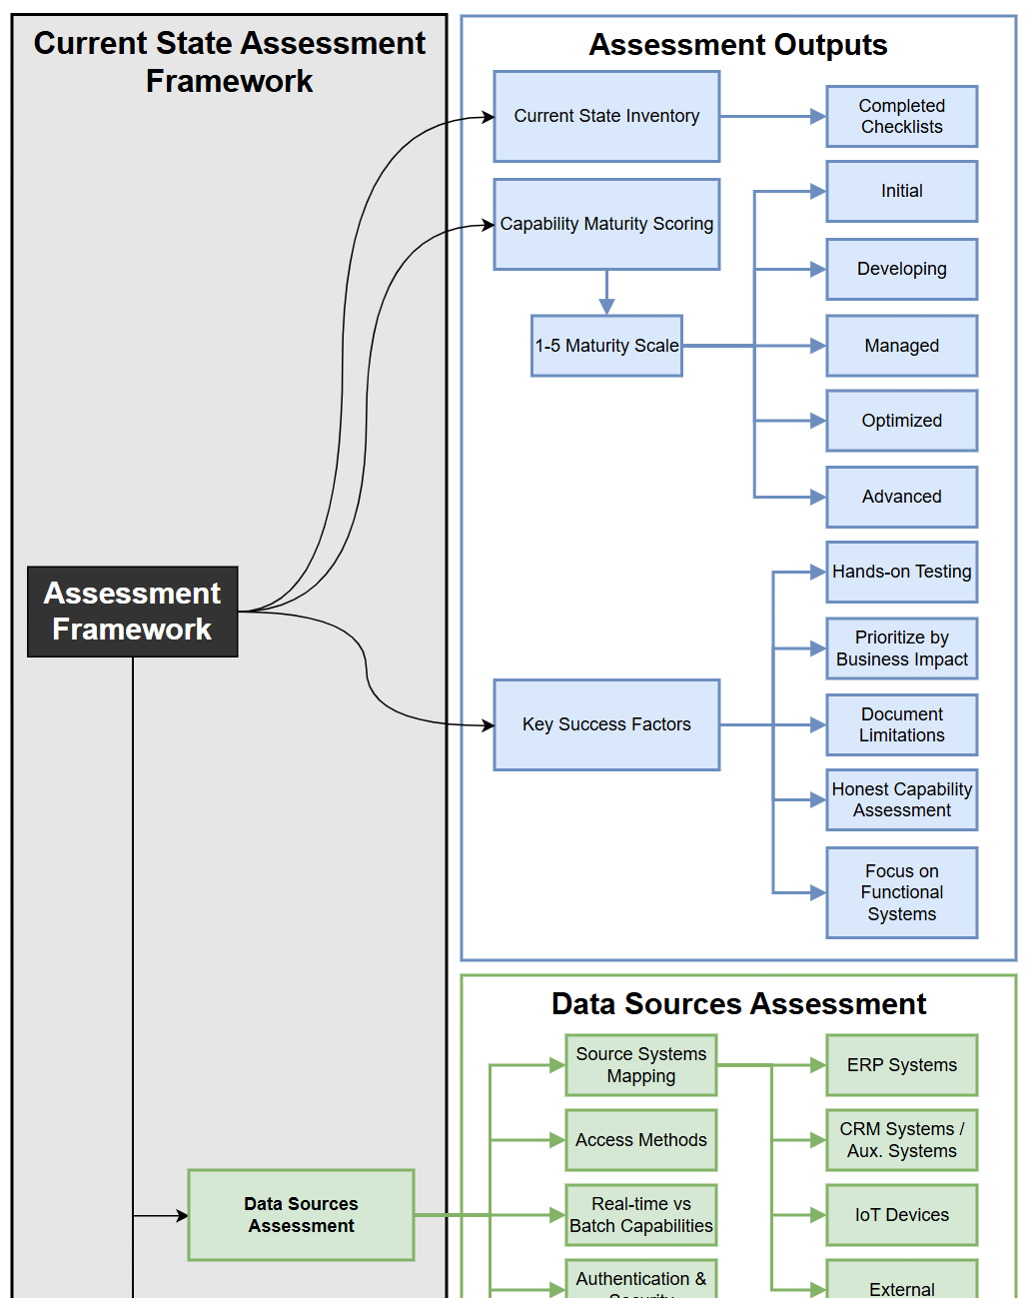
Defining Data & AI capabilities, technology requirements
Defining Data and AI Capabilities and Technology Requirements: Building a Foundation for Project Success – Ross McNeely
Notes:
Why is this important for scope?

Slide 30
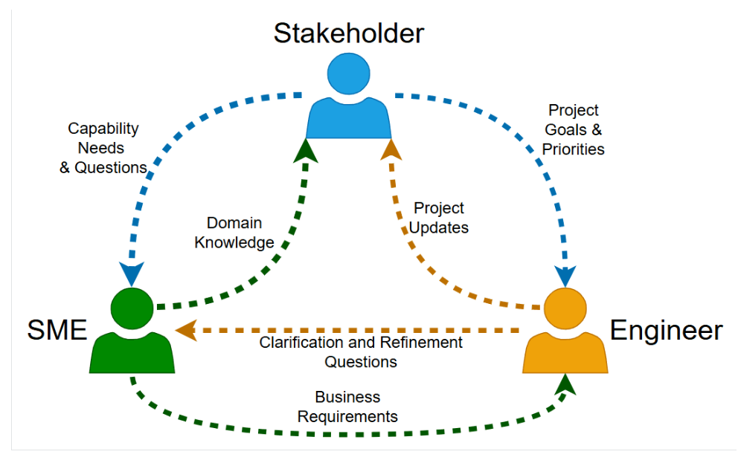
Aligning teams
&
stakeholders for collaboration
The Hidden Key to Data and AI Project Success: Aligning Teams and Stakeholders – Ross McNeely
Notes:
Why is this important for scope?

Slide 31
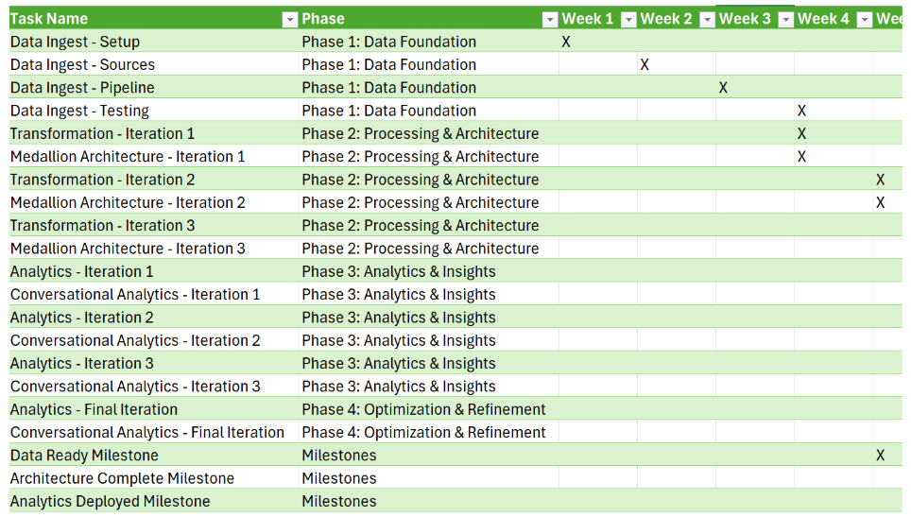
Establishing timelines
&
success metrics
Setting Your Data and AI Projects Up for Success: A Strategic Guide to Timelines and Metrics – Ross McNeely
Notes:
Why is this important for scope?

